Slide 1
Xilinx GPIO Interrupt example

Slide 2
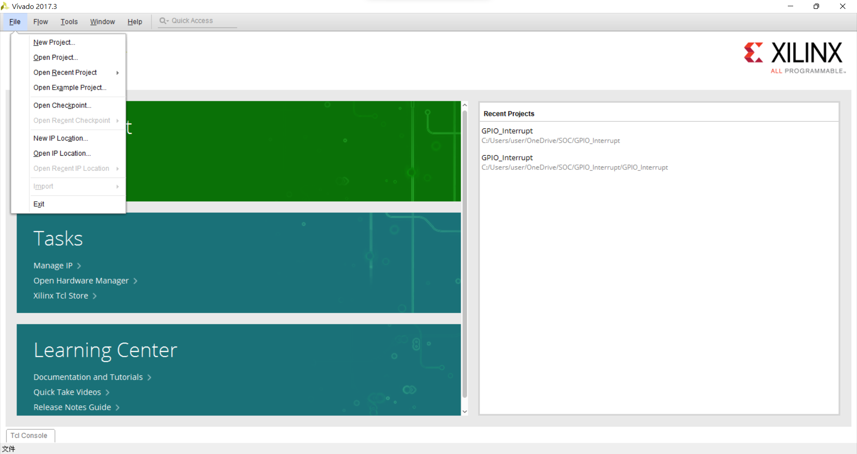
File->New Project

Slide 3

Next

Slide 4
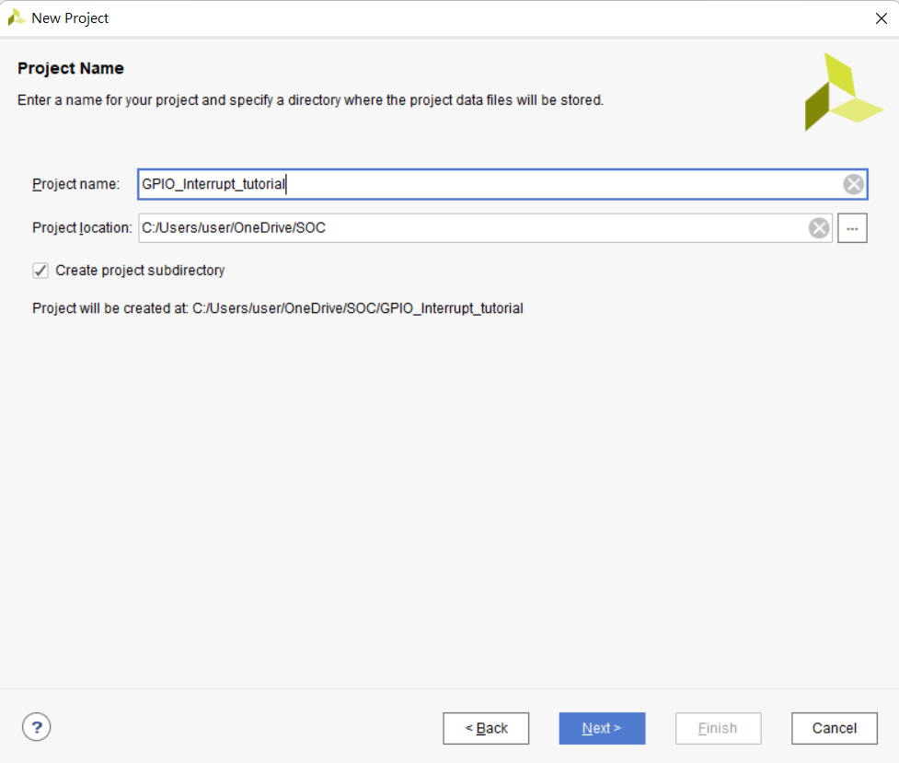
Project name :
設定專案名稱
Project location:
設定專案路徑
Create project subdirectory:
設定專案路徑
設定完後按Next

Slide 5
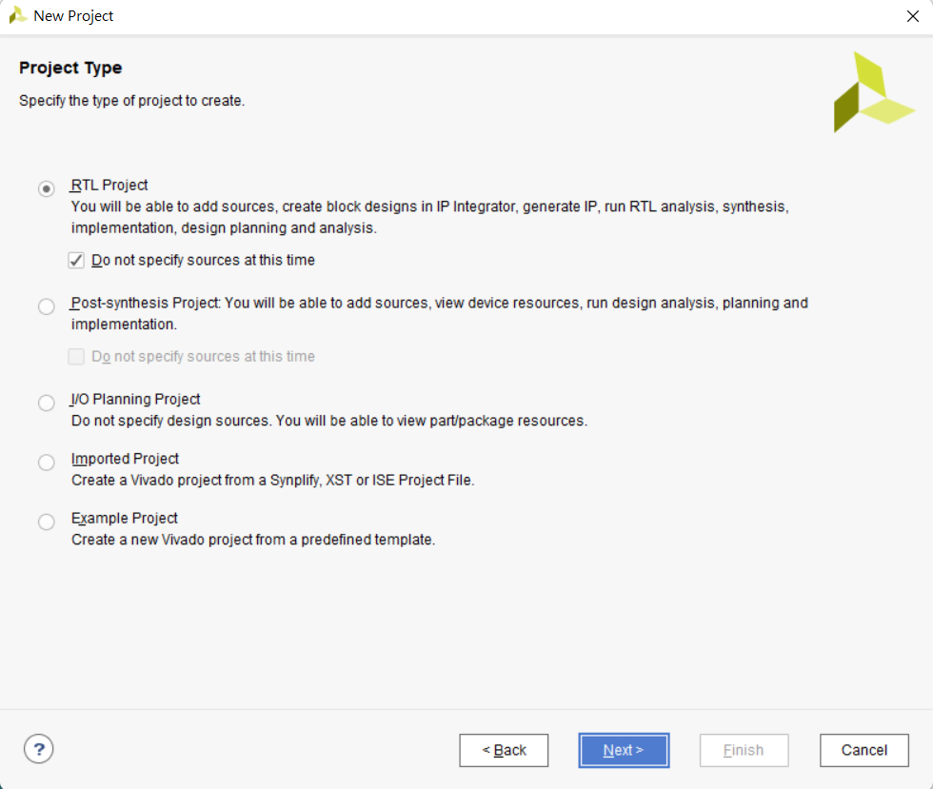
Select Project Type
選擇RTL Project
不指定Sources
選擇後按下一步

Slide 6
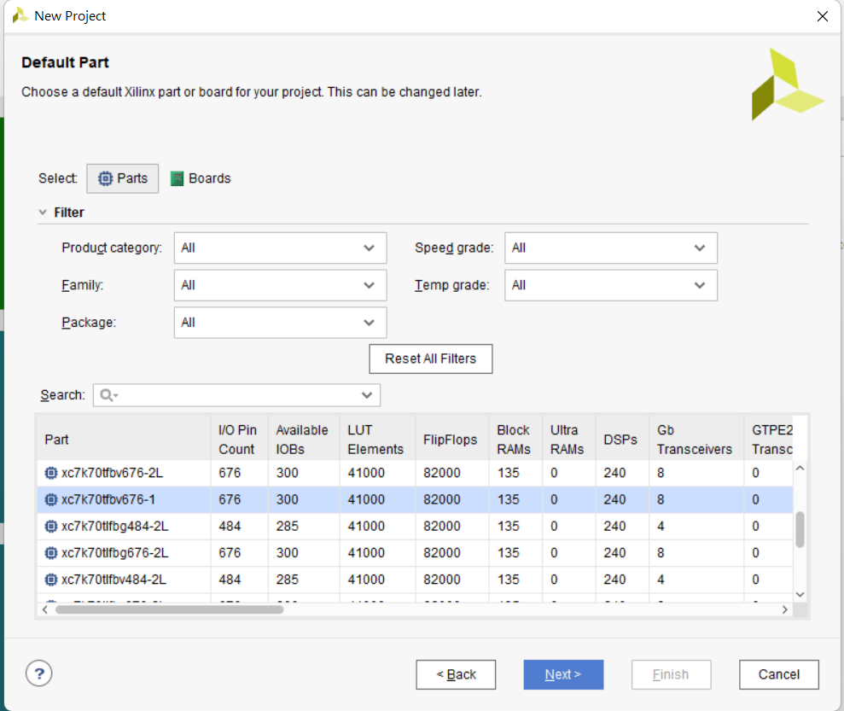
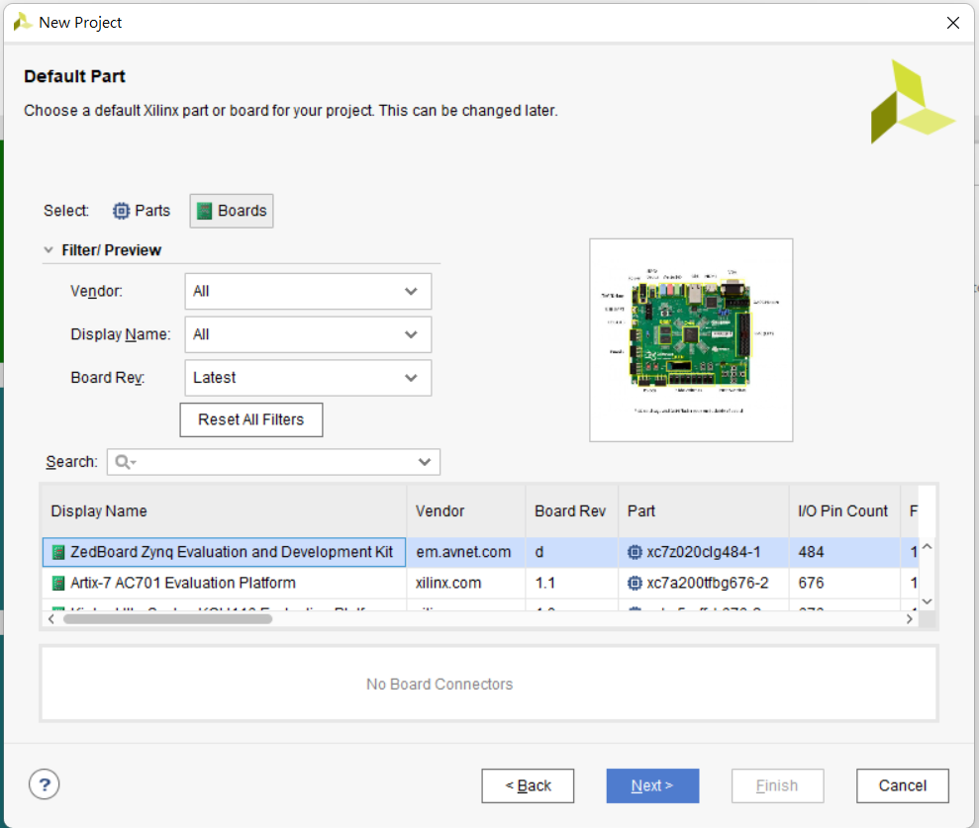
Select your board
選擇Board->Zedbord Zynq Evaluation and Development Kit
選擇完畢後 Next

Slide 7
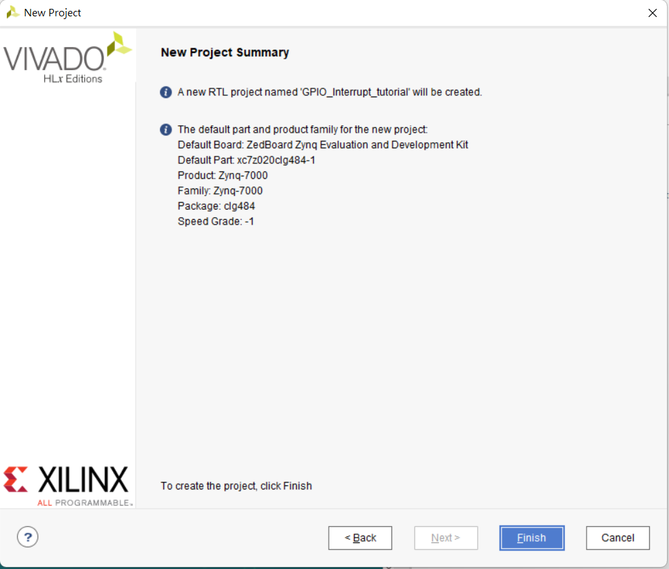

Slide 8
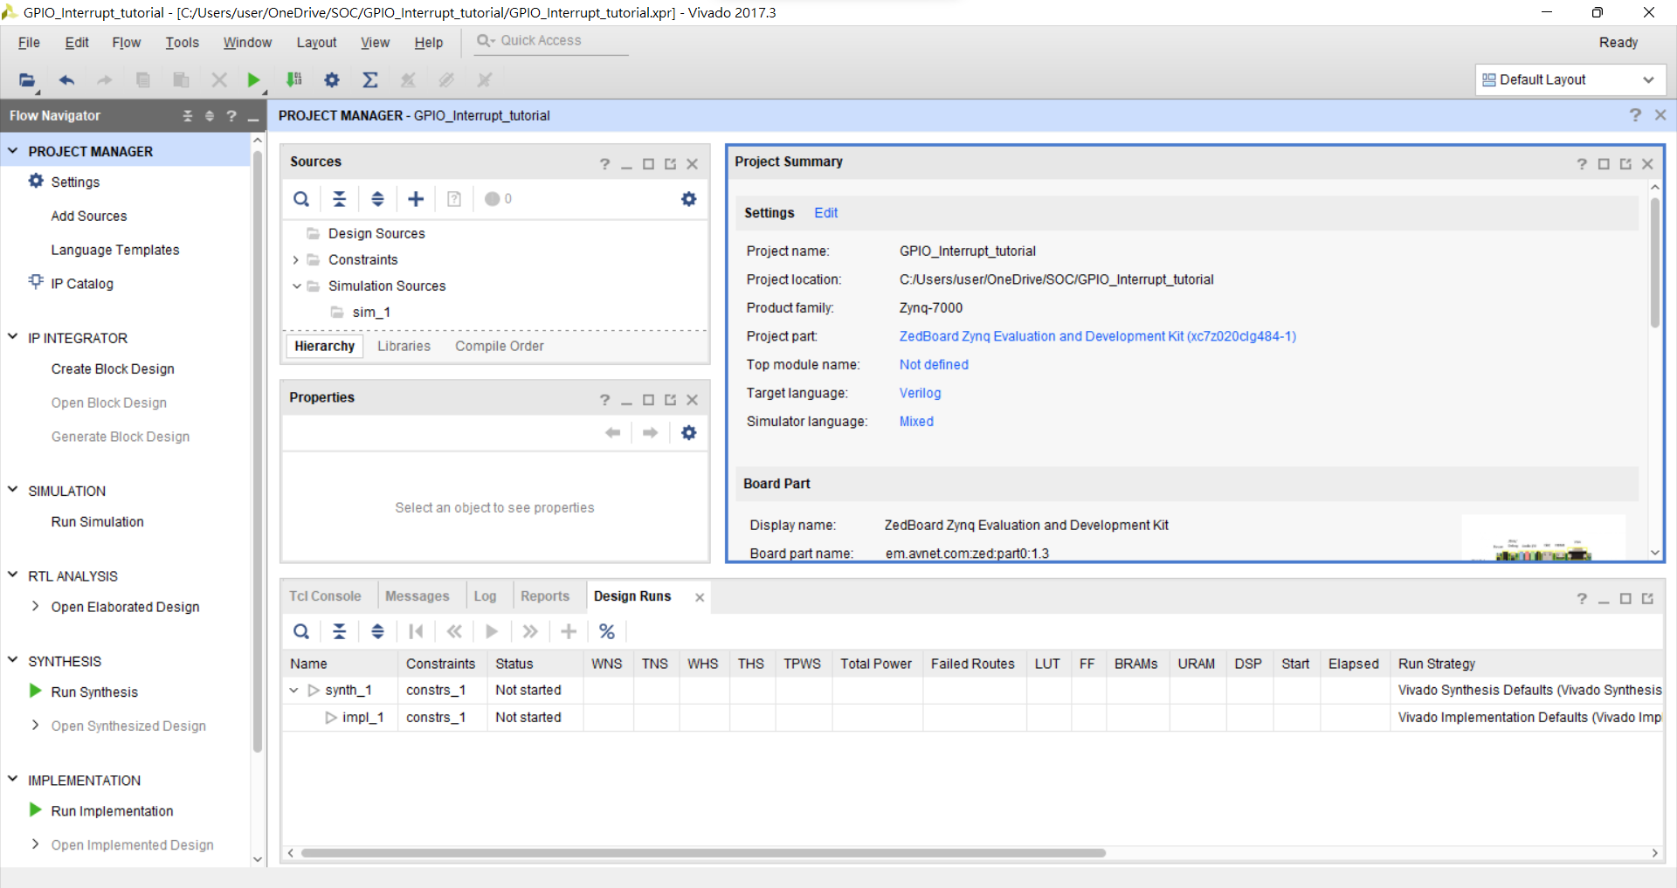
IP INTEGRATOR →Create Block Design

Slide 9
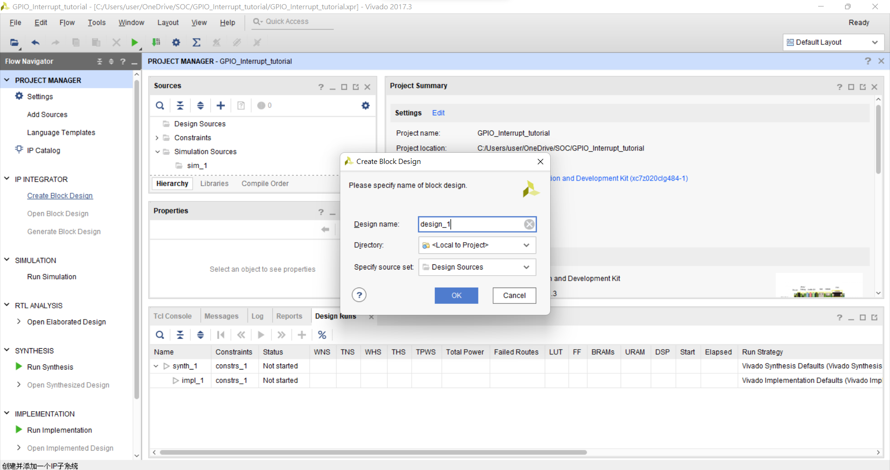

Slide 10
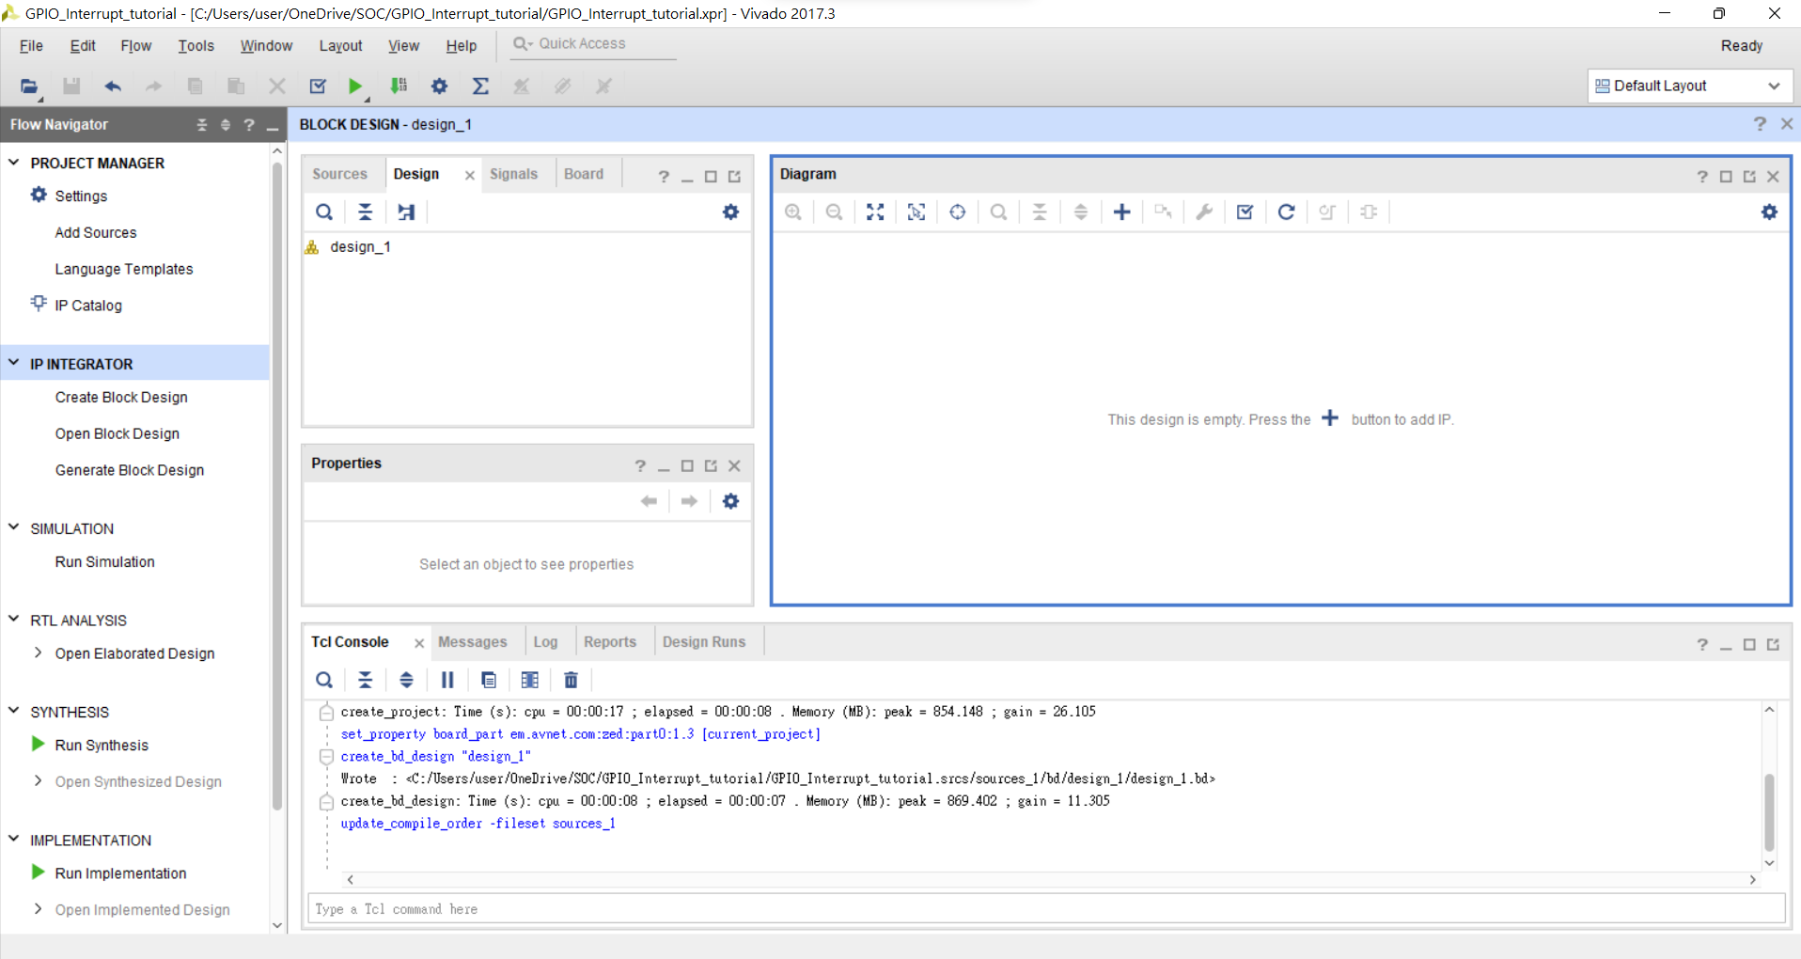
Add IP

Slide 11
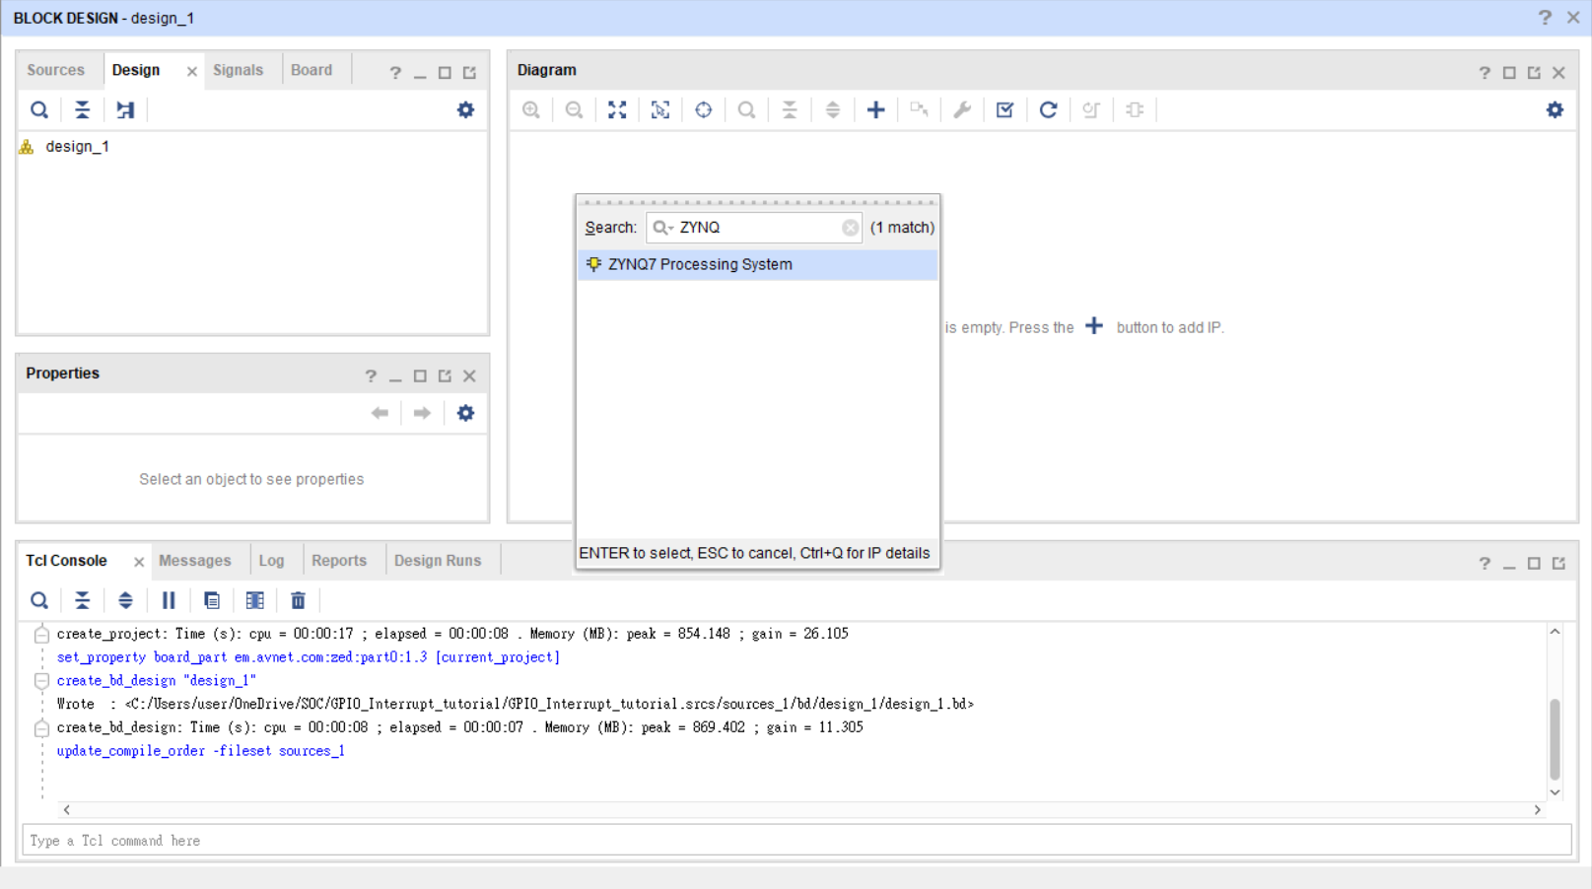
Add PS(Processing system)

Slide 12
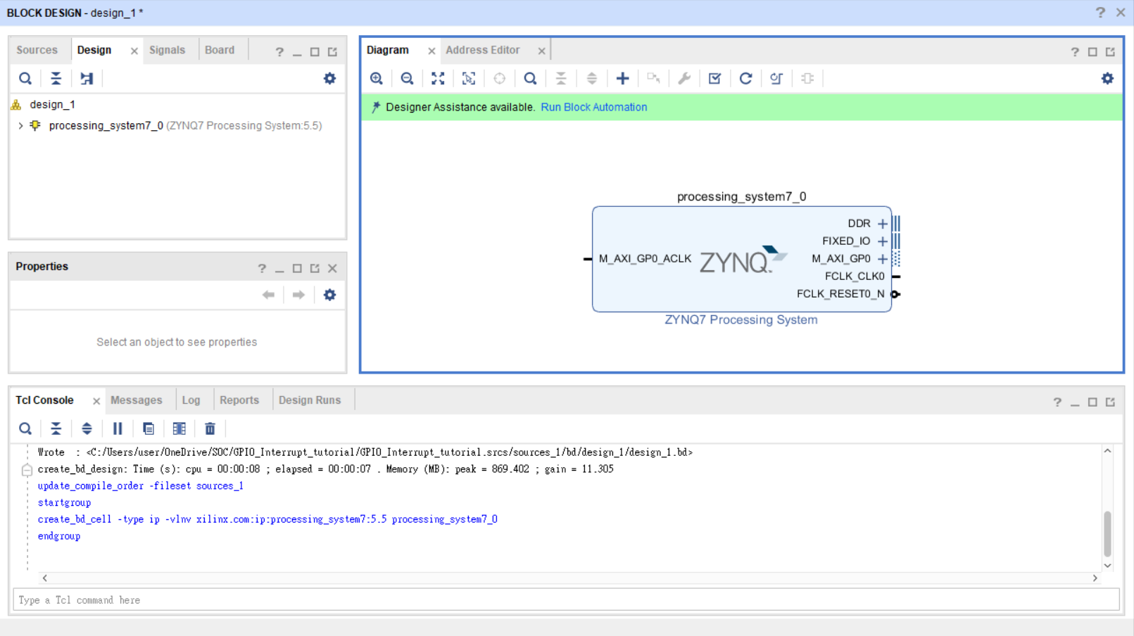
Run block Automation

Slide 13
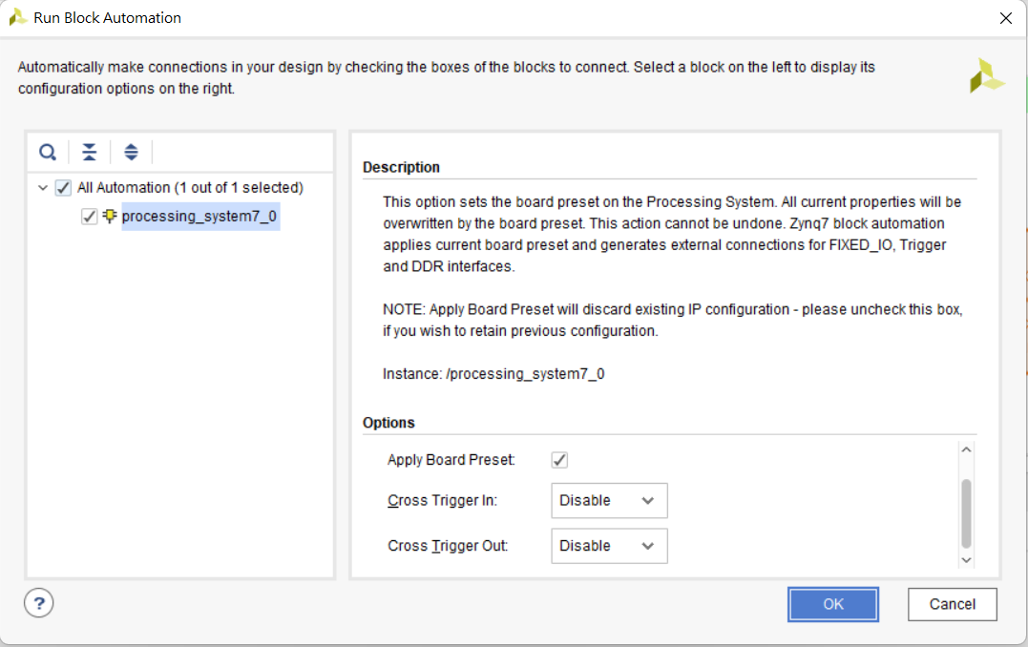
確認完畢後按OK

Slide 14
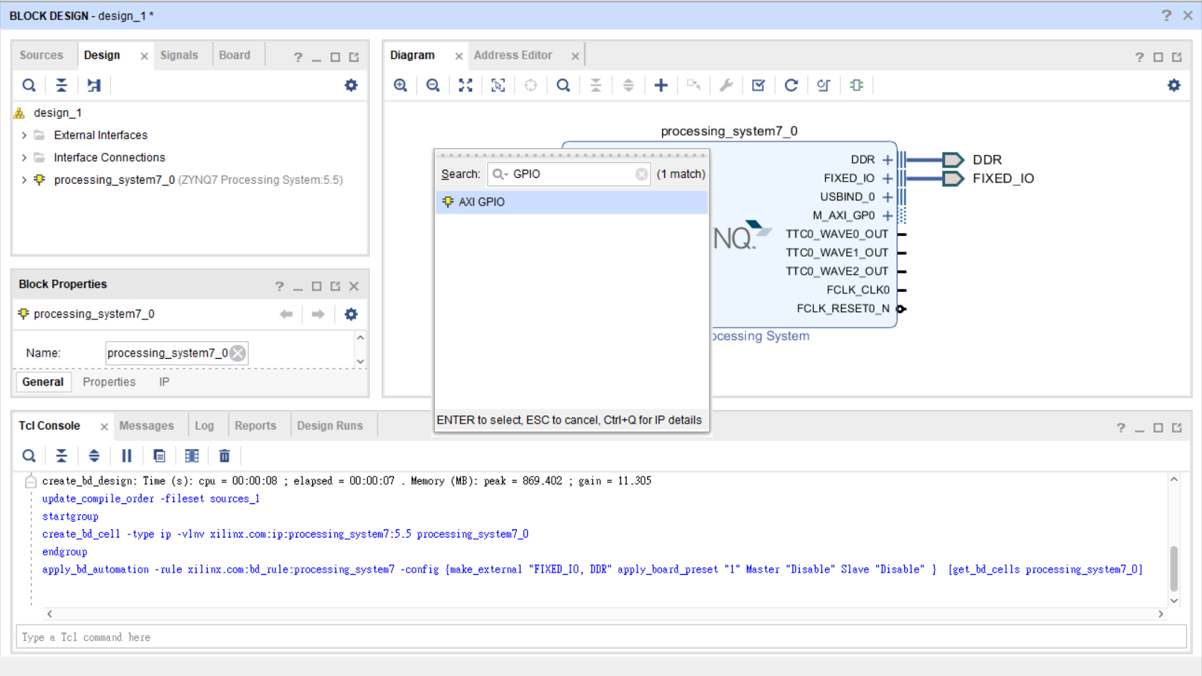
Add two GPIO IP

Slide 15
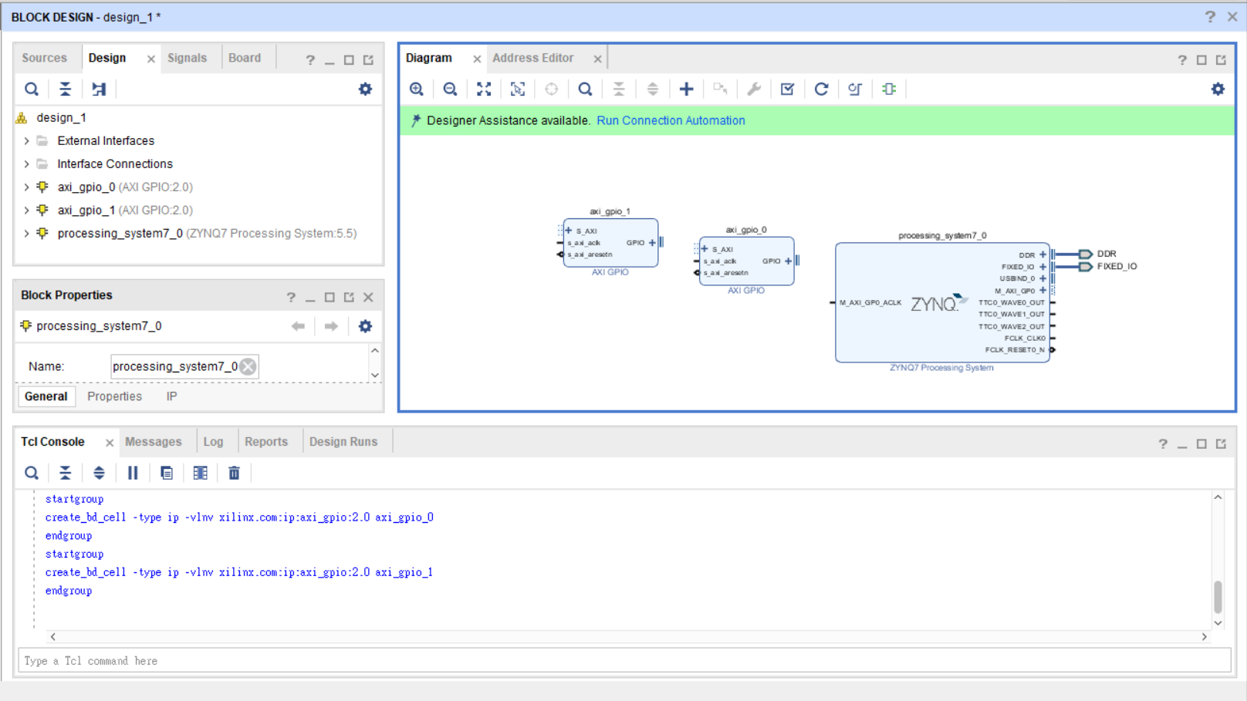
兩個GPIO IP

Slide 16
Setting IP connect

Slide 17
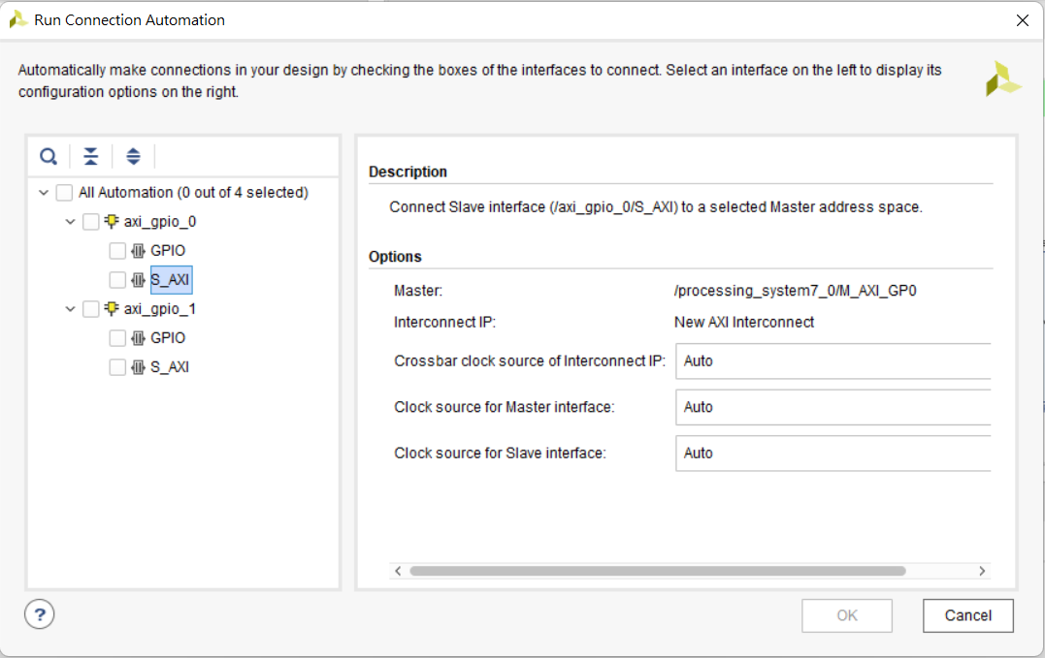
Setting GPIO AXI
皆為Auto

Slide 18
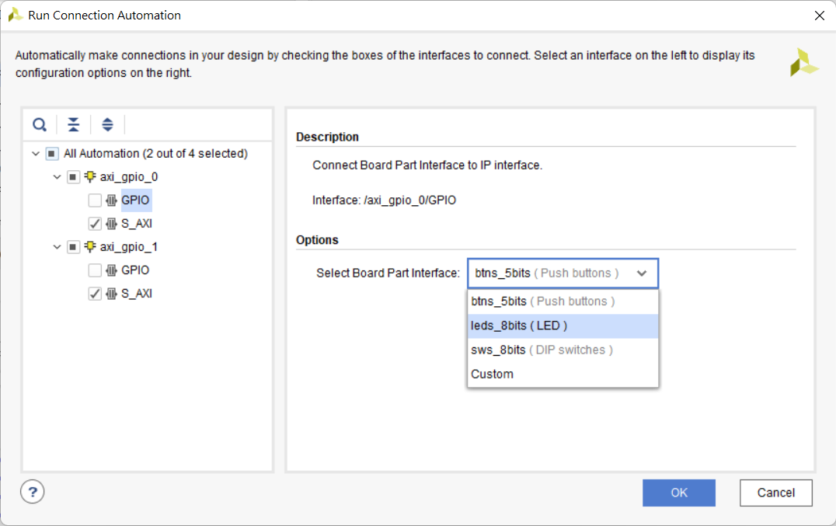
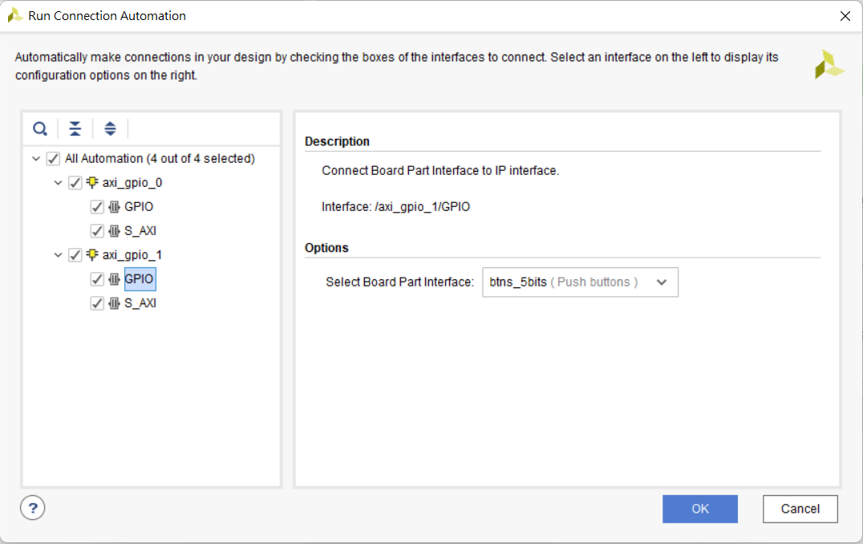
Setting GPIO
設定axi_gpio_0 GPIO Options Select Board Part Interface 為leds_8bits(LED)
設定axi_gpio_1 GPIO Options Select Board Part Interface 為btns_5bits(Puch buttons)
都設定完畢後按下OK

Slide 19
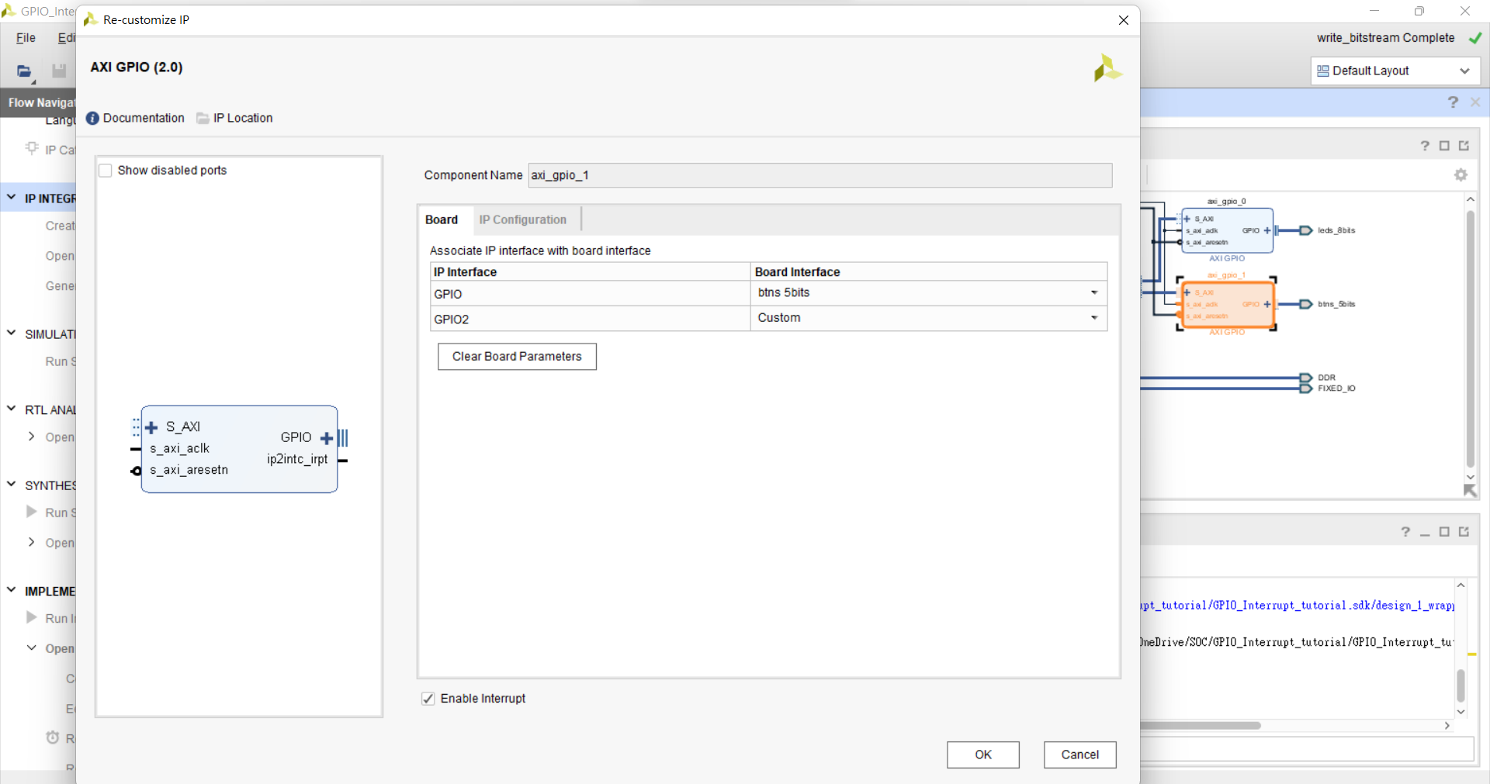
axi_gpio_1 Enable Interrupt

Slide 20
axi_gpio_1 Enable Interrupt

Slide 21
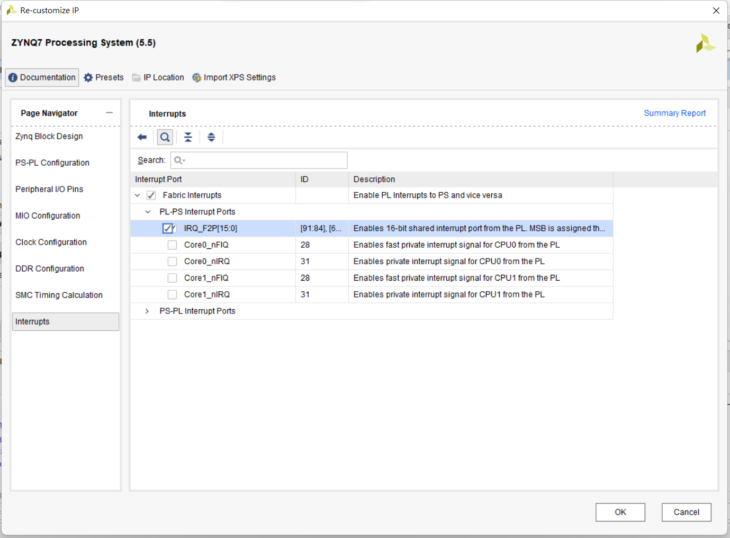
Processing system Enable IRQ

Slide 22
Processing system Enable IRQ

Slide 23
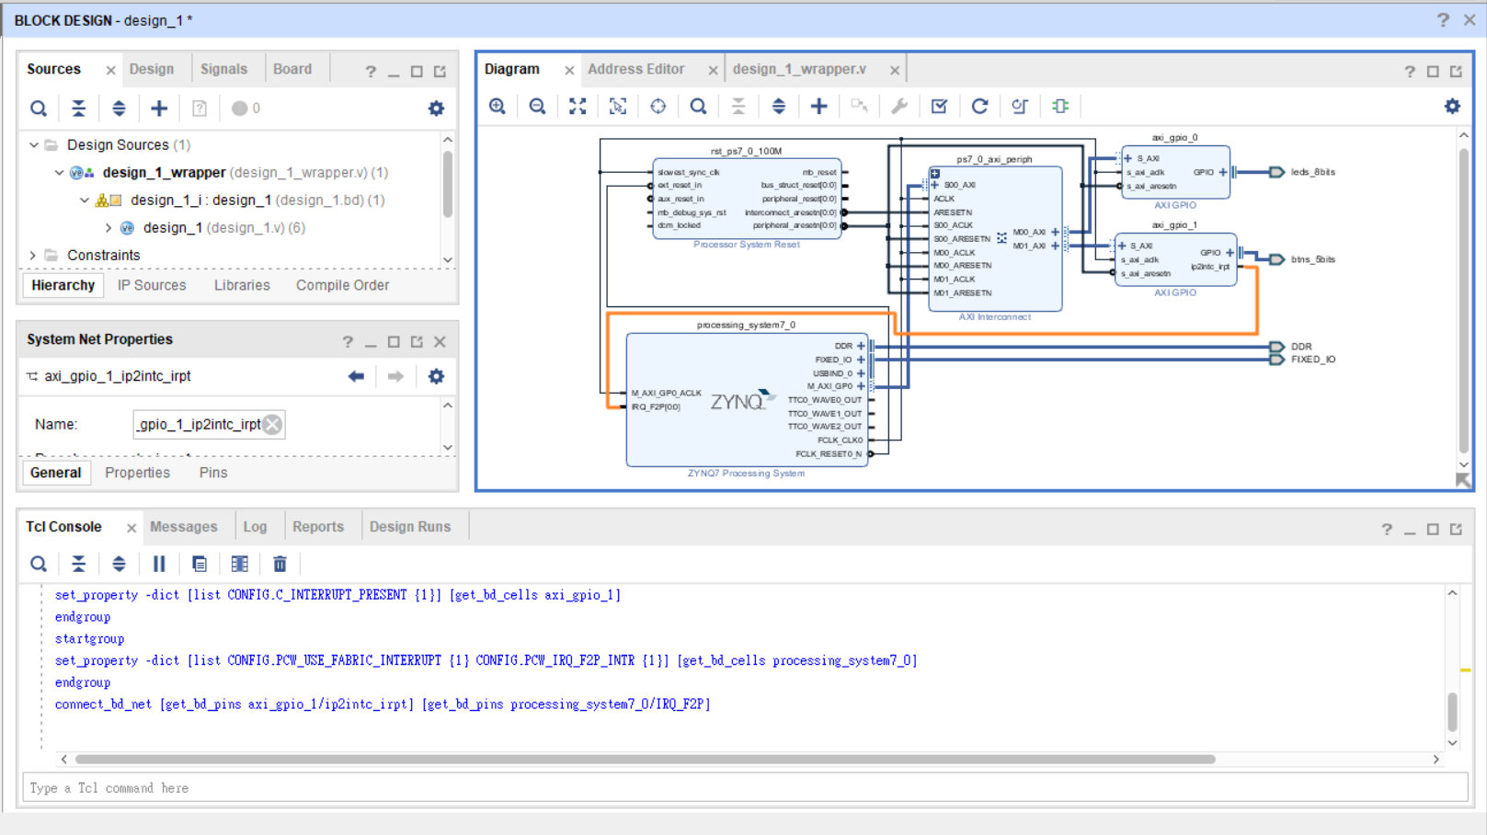
將線路連接起來

Slide 24
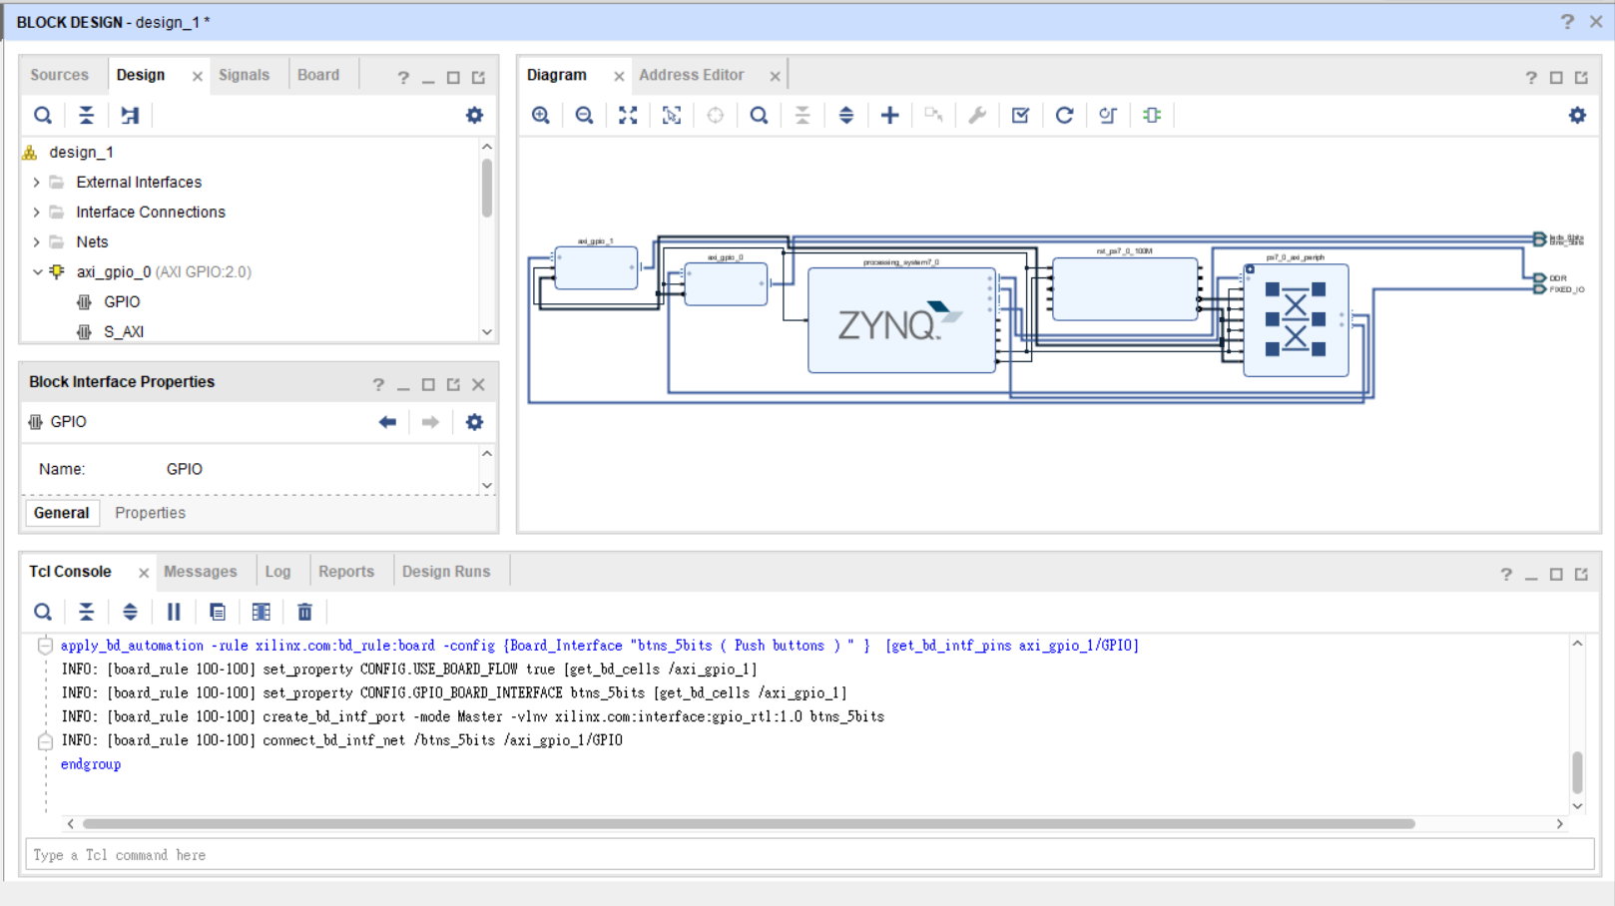
Regenerate layout

Slide 25
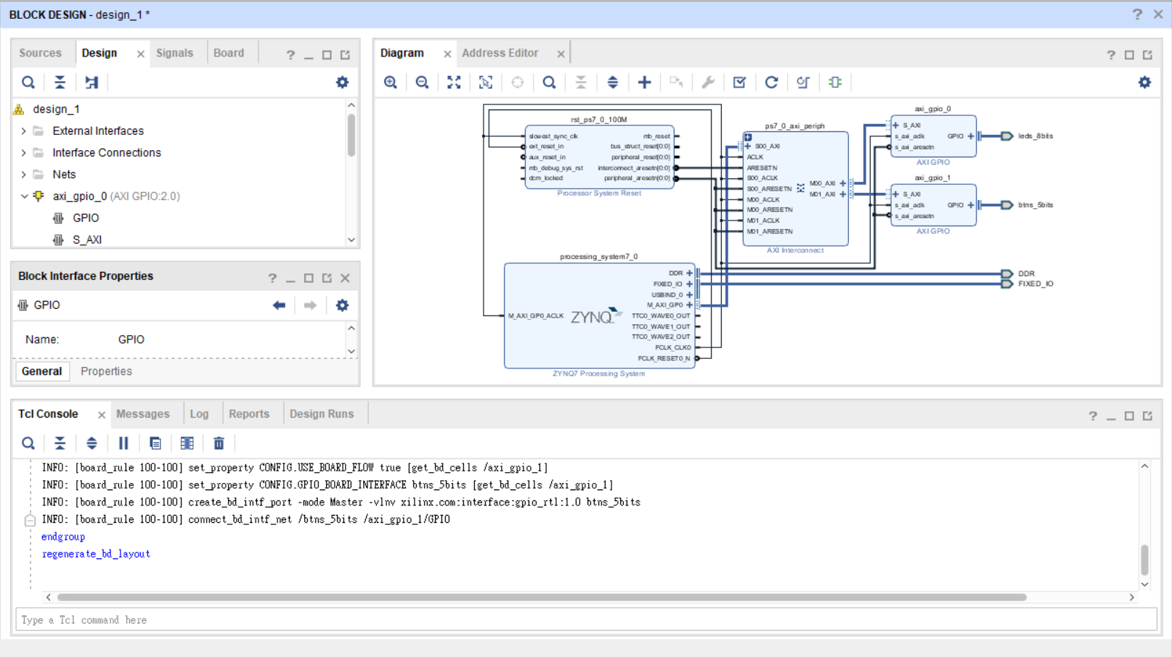
Validation design

Slide 26
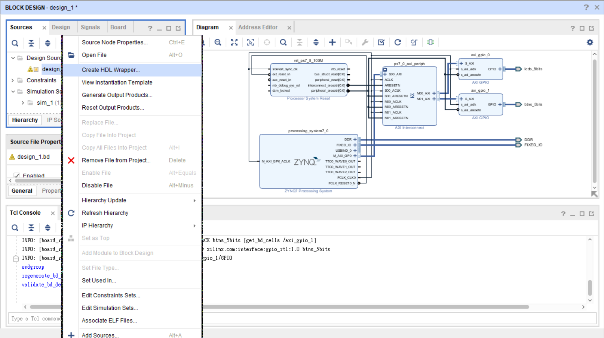
Create HDL wrapper

Slide 27
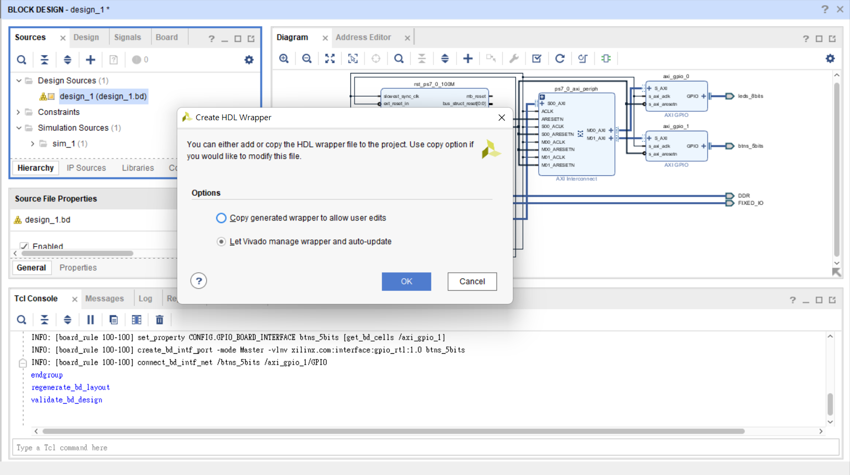

Slide 28
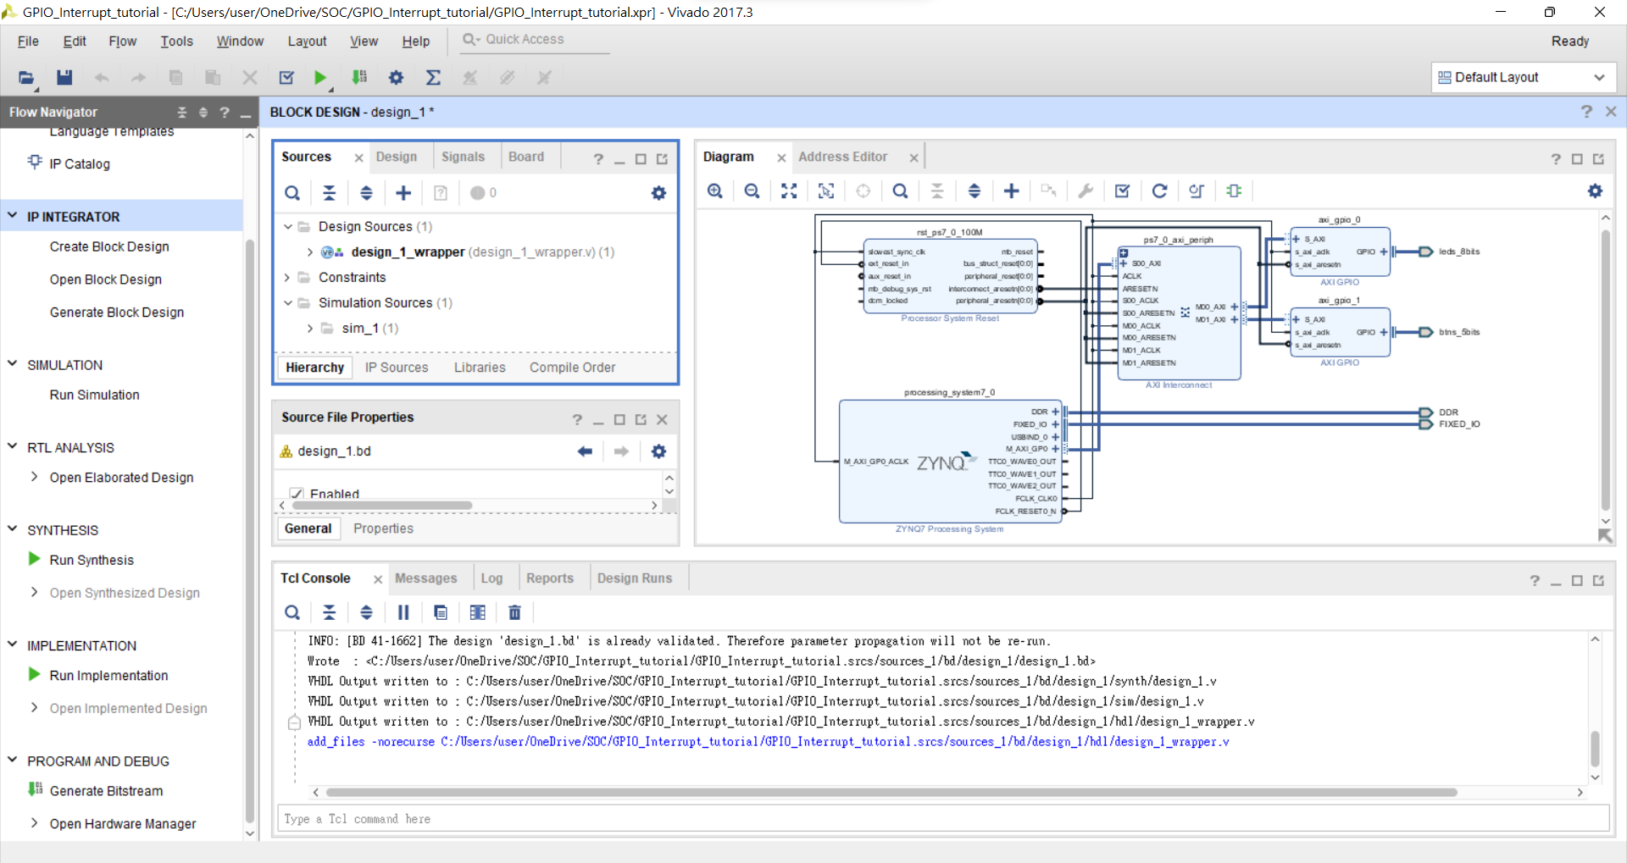
Generate Bitstream

Slide 29
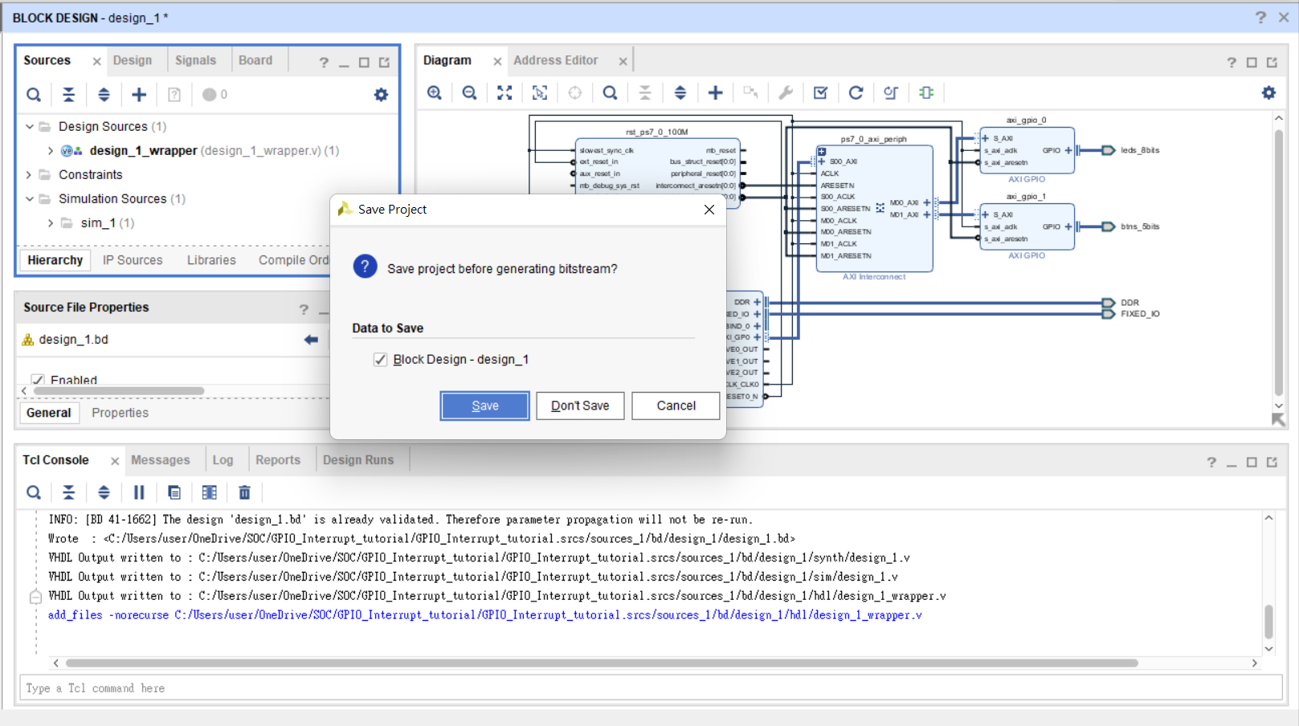

Slide 30
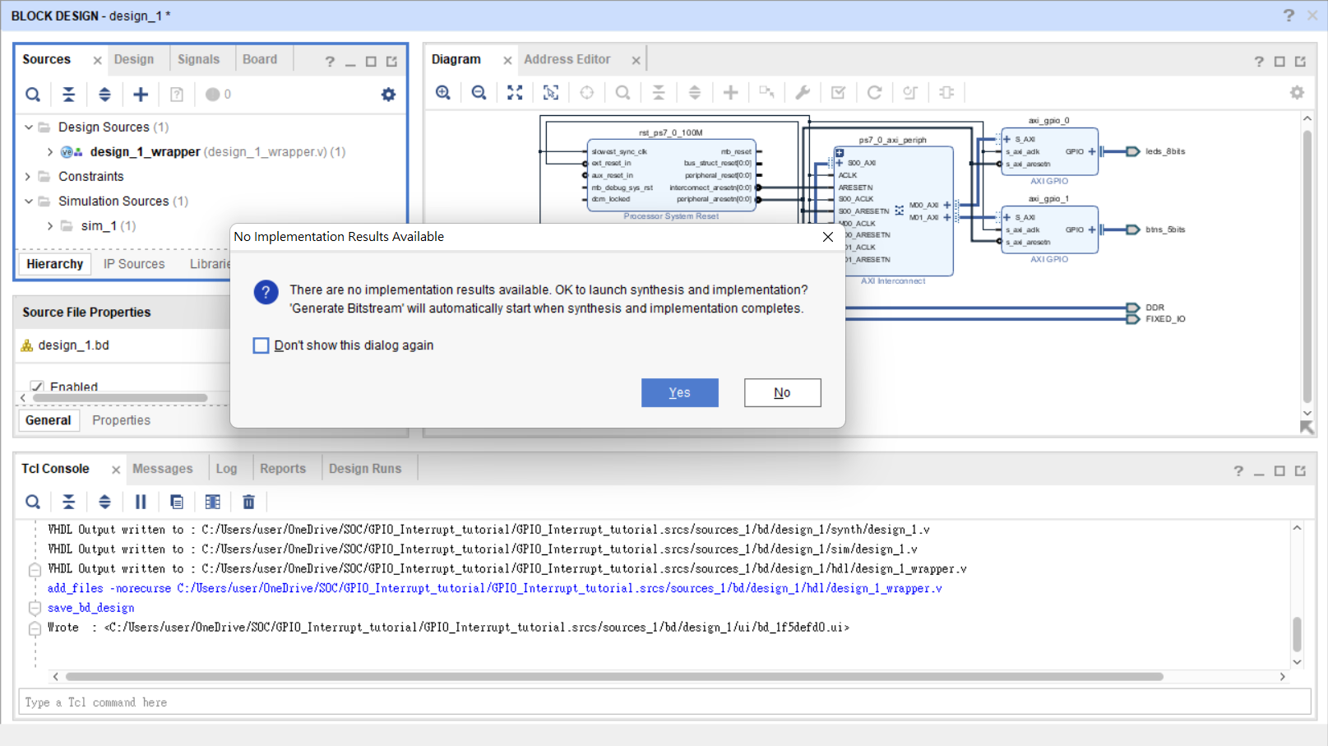

Slide 31
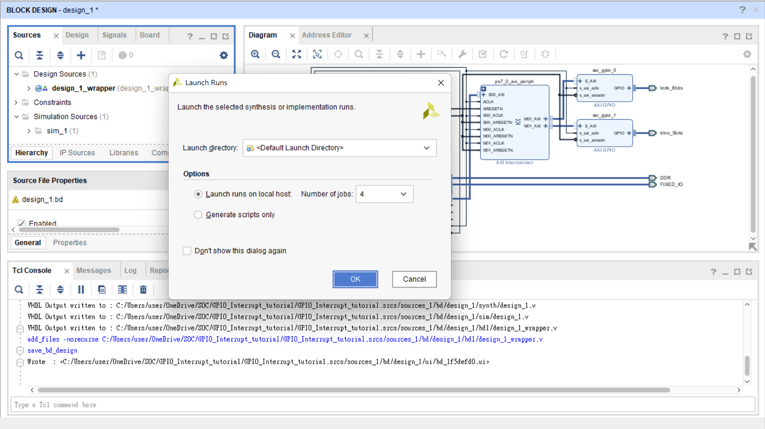

Slide 32
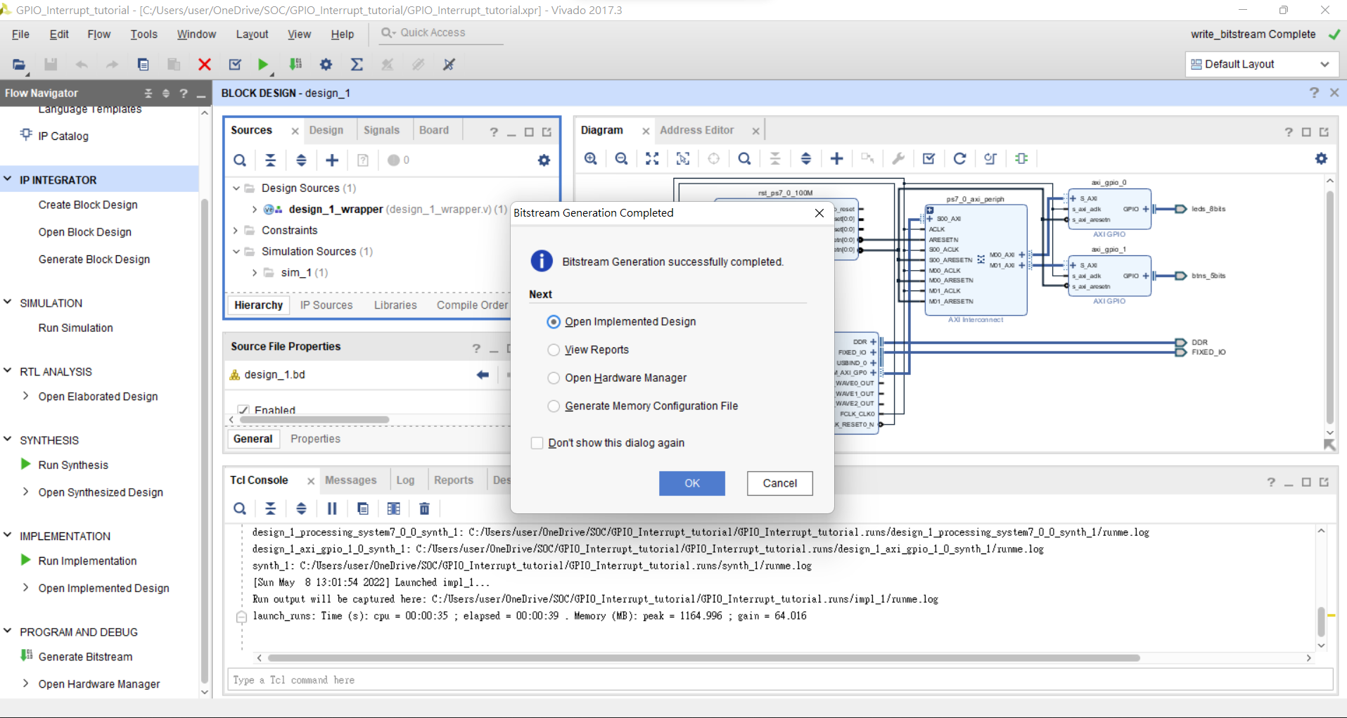

Slide 33
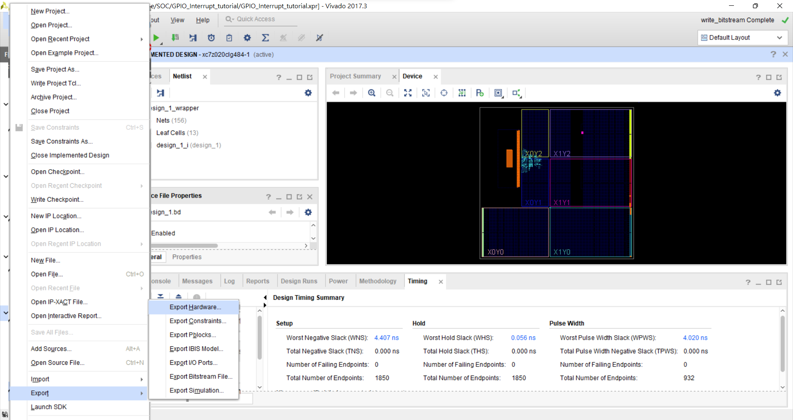
File→Export→Export Hardware

Slide 34
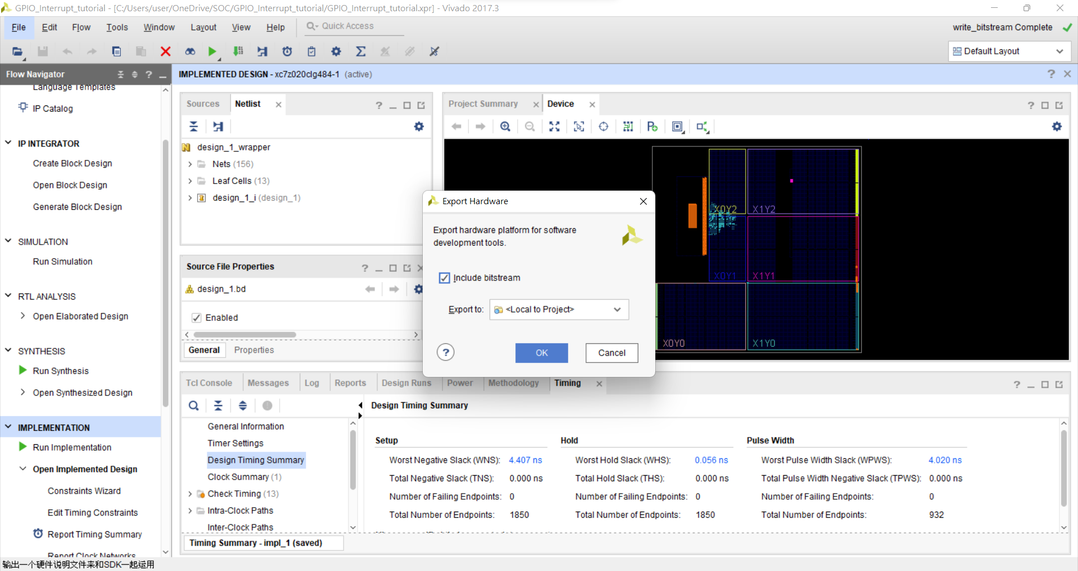

Slide 35
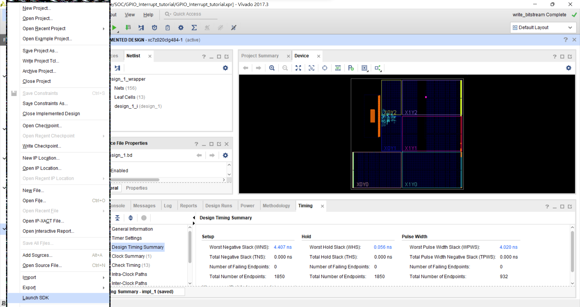
File→ Launch SDK

Slide 36
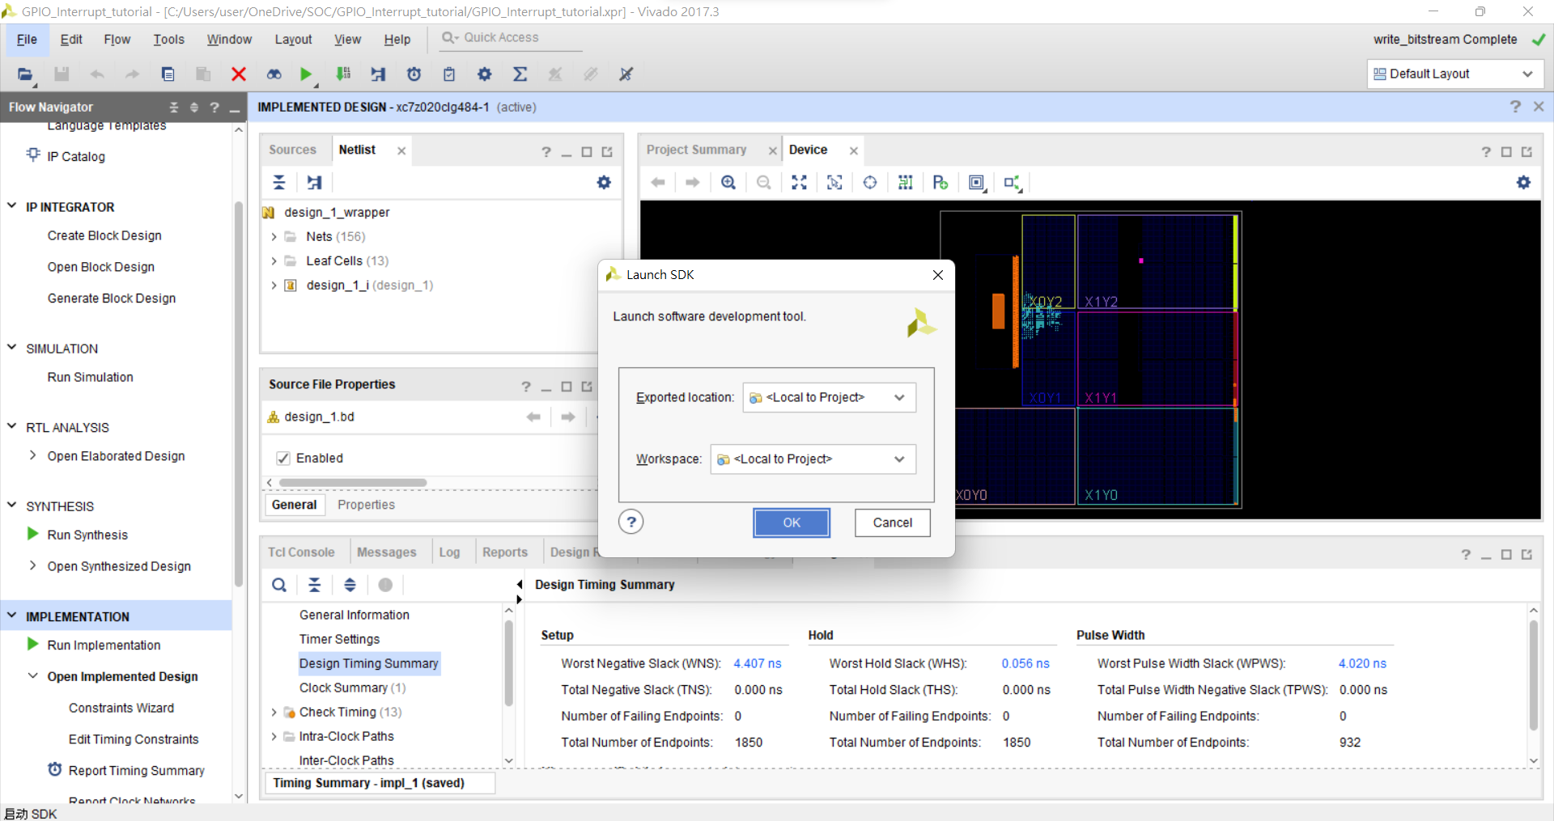

Slide 37
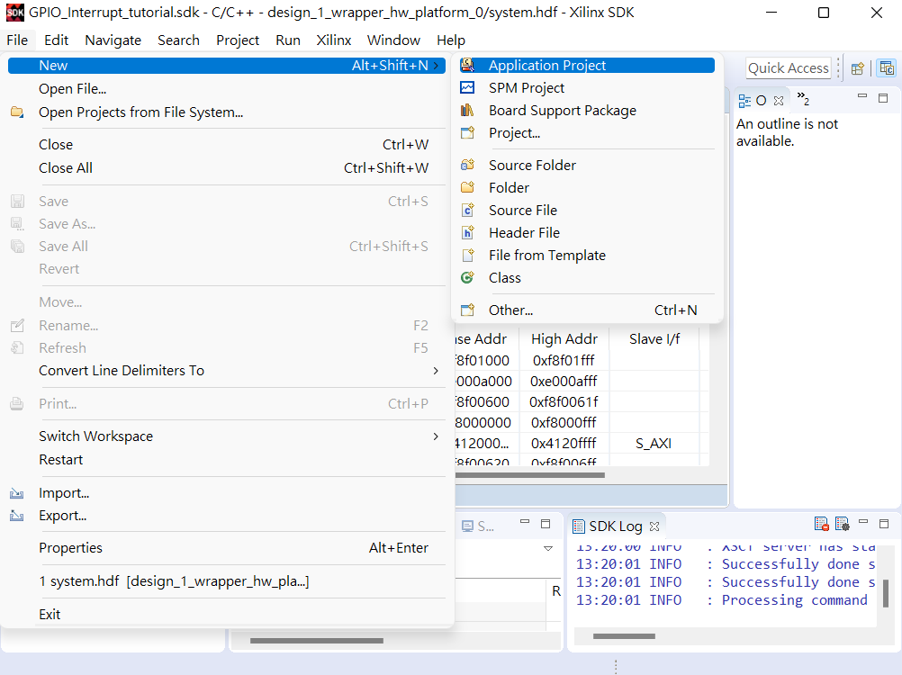
File→New→application project

Slide 38
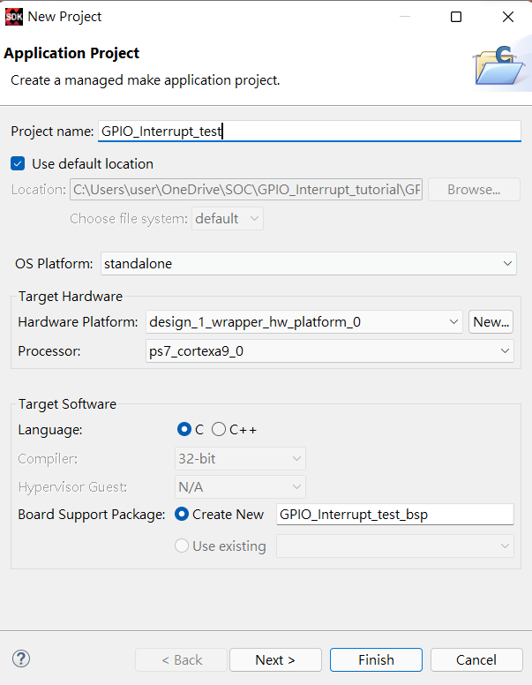
設定專案名稱

Slide 39
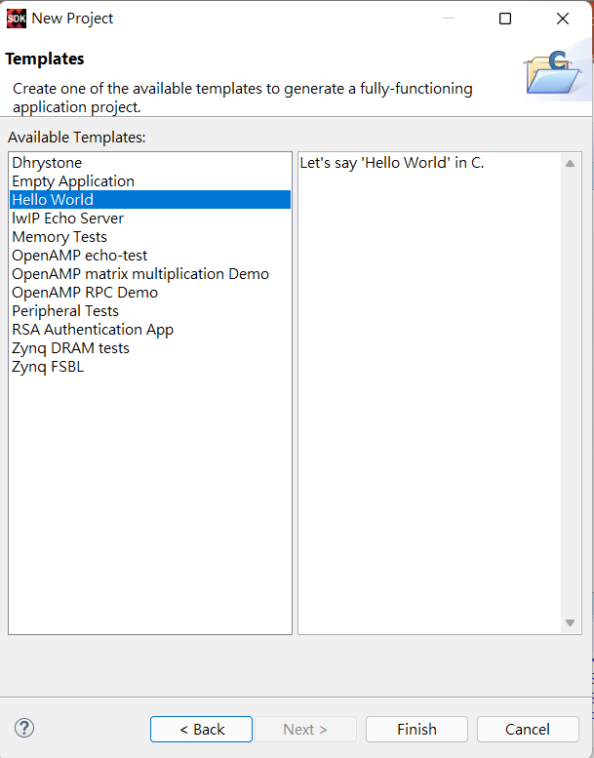
選擇Hello World Template

Slide 40
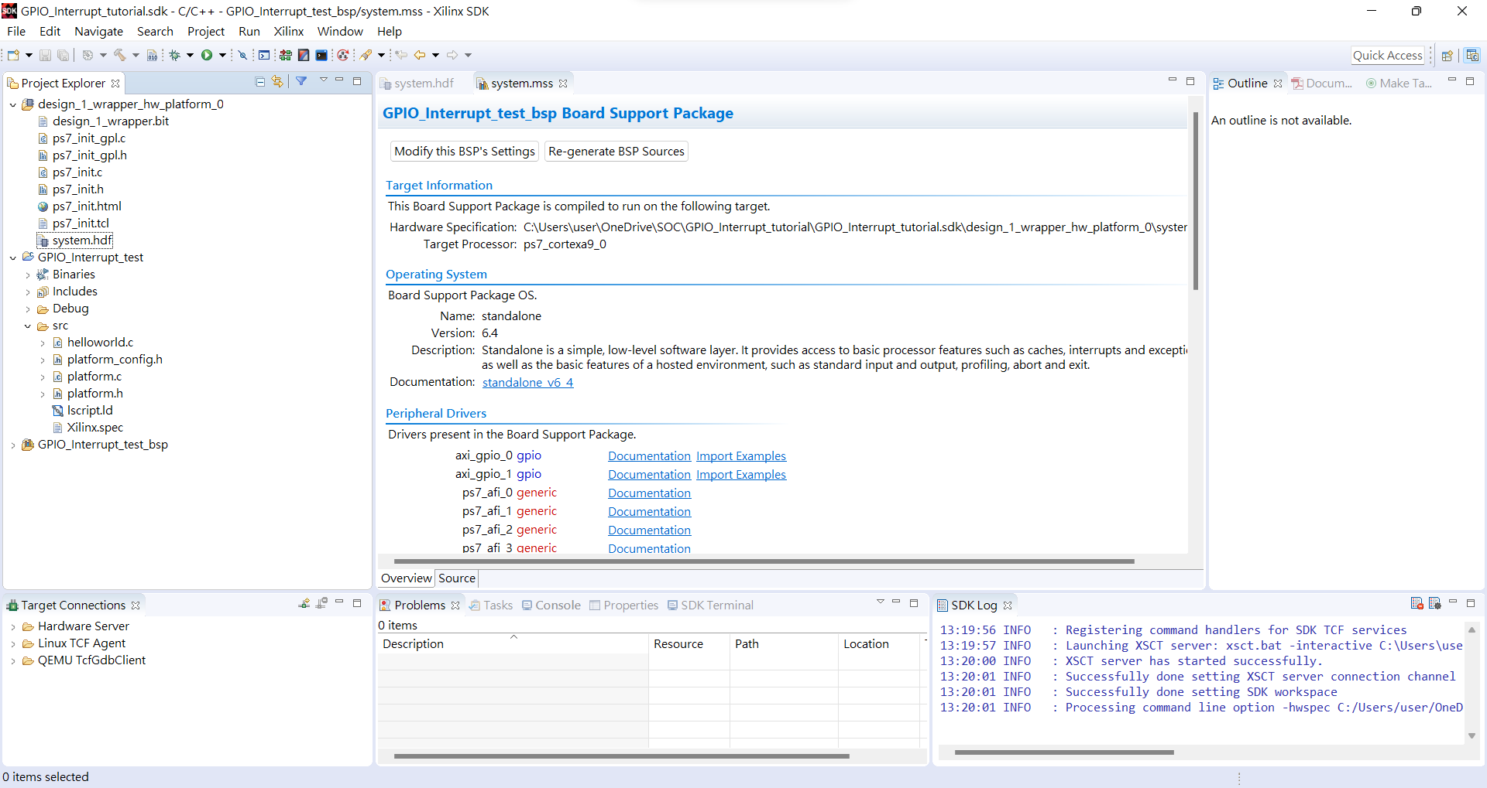
Project Explore →GPIO_Interrupt_test→src→helloworld.c
點兩下編輯

Slide 41
Edit code
Include header file
Parameter definitions
#include <stdio.h>
#include "platform.h“
#include "xparameters.h“
#include "xgpio.h“
#include "xscugic.h“
#include "xil_exception.h“
#include "xil_printf.h"
#define INTC_DEVICE_ID XPAR_PS7_SCUGIC_0_DEVICE_ID
#define BTNS_DEVICE_ID XPAR_AXI_GPIO_1_DEVICE_ID
#define LEDS_DEVICE_ID XPAR_AXI_GPIO_0_DEVICE_ID
#define INTC_GPIO_INTERRUPT_ID XPAR_FABRIC_AXI_GPIO_1_IP2INTC_IRPT_INTR
#define BTN_INT XGPIO_IR_CH1_MASK
XGpio LEDInst, BTNInst;
XScuGic INTCInst;
static int led_data;
static int btn_value;
Reference:GPIO interrupt and processes (xilinx.com)

Slide 42
Edit code
PROTOTYPE FUNCTIONS
static void BTN_Intr_Handler(void *baseaddr_p);
static int InterruptSystemSetup(XScuGic *XScuGicInstancePtr);
static int IntcInitFunction(u16 DeviceId, XGpio *GpioInstancePtr);

Slide 43
Edit code
INTERRUPT HANDLER FUNCTIONS
void BTN_Intr_Handler(void *InstancePtr) {
// Disable GPIO interrupts
XGpio_InterruptDisable(&BTNInst, BTN_INT);
// Ignore additional button presses
if ((XGpio_InterruptGetStatus(&BTNInst) & BTN_INT) != BTN_INT) {
return;
}
btn_value = XGpio_DiscreteRead(&BTNInst, 1);
// Increment counter based on button value
// Reset if centre button pressed
if (btn_value != 1)
led_data = led_data + btn_value;
else
led_data = 0;
XGpio_DiscreteWrite(&LEDInst, 1, led_data);
(void) XGpio_InterruptClear(&BTNInst, BTN_INT);
// Enable GPIO interrupts
XGpio_InterruptEnable(&BTNInst, BTN_INT);
}

Slide 44
Edit code
INITIAL SETUP FUNCTIONS
int InterruptSystemSetup(XScuGic *XScuGicInstancePtr) {
// Enable interrupt
XGpio_InterruptEnable(&BTNInst, BTN_INT);
XGpio_InterruptGlobalEnable(&BTNInst);
Xil_ExceptionRegisterHandler(XIL_EXCEPTION_ID_INT,
(Xil_ExceptionHandler) XScuGic_InterruptHandler,
XScuGicInstancePtr);
Xil_ExceptionEnable();
return XST_SUCCESS;
}

Slide 45
int IntcInitFunction(u16 DeviceId, XGpio *GpioInstancePtr) {
XScuGic_Config *IntcConfig;
int status;
// Interrupt controller initialization
IntcConfig = XScuGic_LookupConfig(DeviceId);
status = XScuGic_CfgInitialize(&INTCInst, IntcConfig, IntcConfig->CpuBaseAddress);
if (status != XST_SUCCESS)
return XST_FAILURE;
// Call to interrupt setup
status = InterruptSystemSetup(&INTCInst);
if (status != XST_SUCCESS)
return XST_FAILURE;
// Connect GPIO interrupt to handler
status = XScuGic_Connect(&INTCInst, INTC_GPIO_INTERRUPT_ID,
(Xil_ExceptionHandler) BTN_Intr_Handler, (void *) GpioInstancePtr);
if (status != XST_SUCCESS)
return XST_FAILURE;
// Enable GPIO interrupts interrupt
XGpio_InterruptEnable(GpioInstancePtr, 1);
XGpio_InterruptGlobalEnable(GpioInstancePtr);
// Enable GPIO and timer interrupts in the controller
XScuGic_Enable(&INTCInst, INTC_GPIO_INTERRUPT_ID);
return XST_SUCCESS;
}

Slide 46
main
int main()
{
init_platform();
int status;
status = XGpio_Initialize(&LEDInst, LEDS_DEVICE_ID); // Initialise LEDs
if (status != XST_SUCCESS)
return XST_FAILURE;
status = XGpio_Initialize(&BTNInst, BTNS_DEVICE_ID); // Initialise Push Buttons
if (status != XST_SUCCESS)
return XST_FAILURE;
XGpio_SetDataDirection(&LEDInst, 1, 0x00); // Set LEDs direction to outputs
XGpio_SetDataDirection(&BTNInst, 1, 0xFF); // Set all buttons direction to inputs
status = IntcInitFunction(INTC_DEVICE_ID, &BTNInst); // Initialize interrupt controller
if (status != XST_SUCCESS)
return XST_FAILURE;
while (1);
cleanup_platform();
return 0;
}

Slide 47
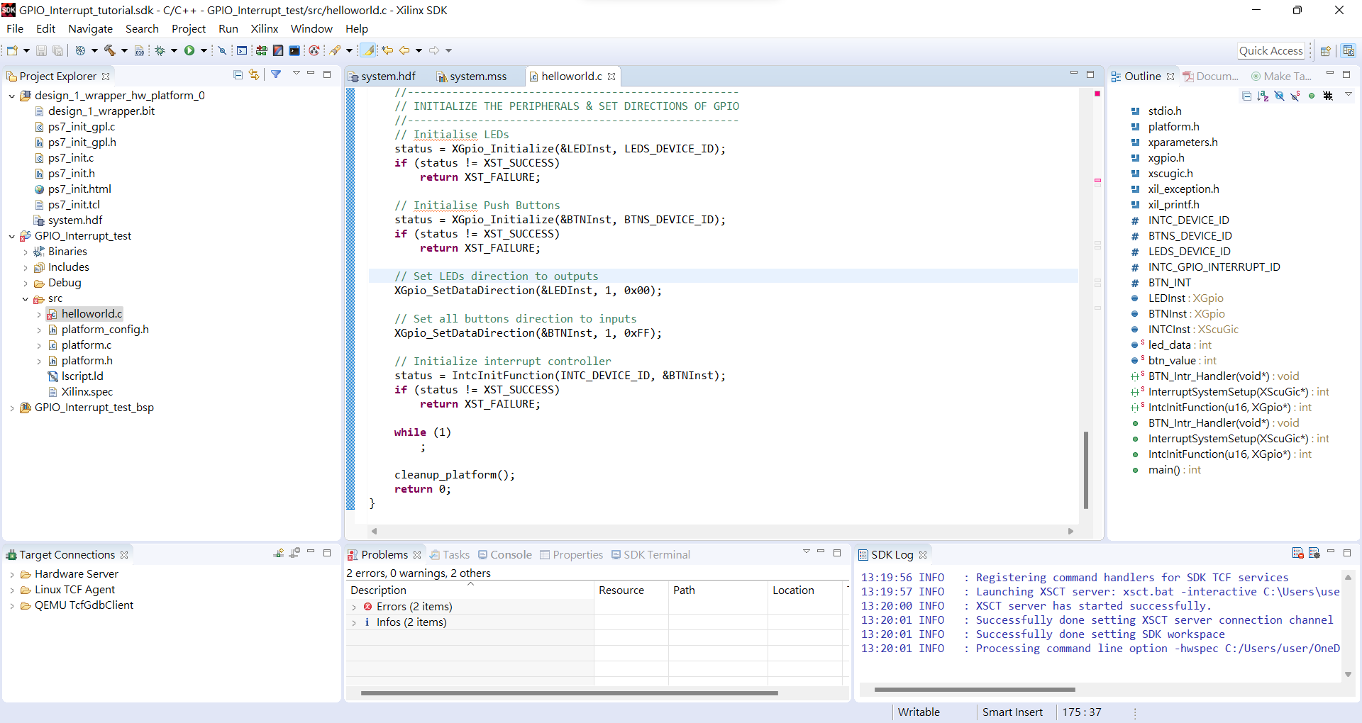
Program FPGA

Slide 48
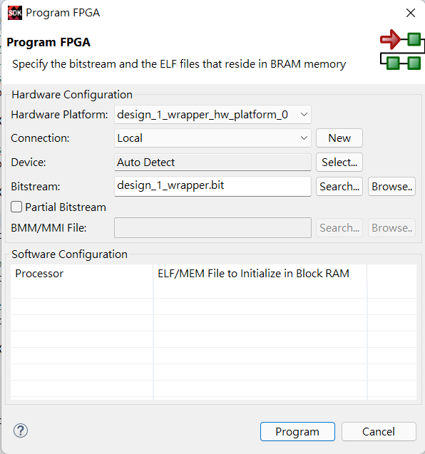

Slide 49
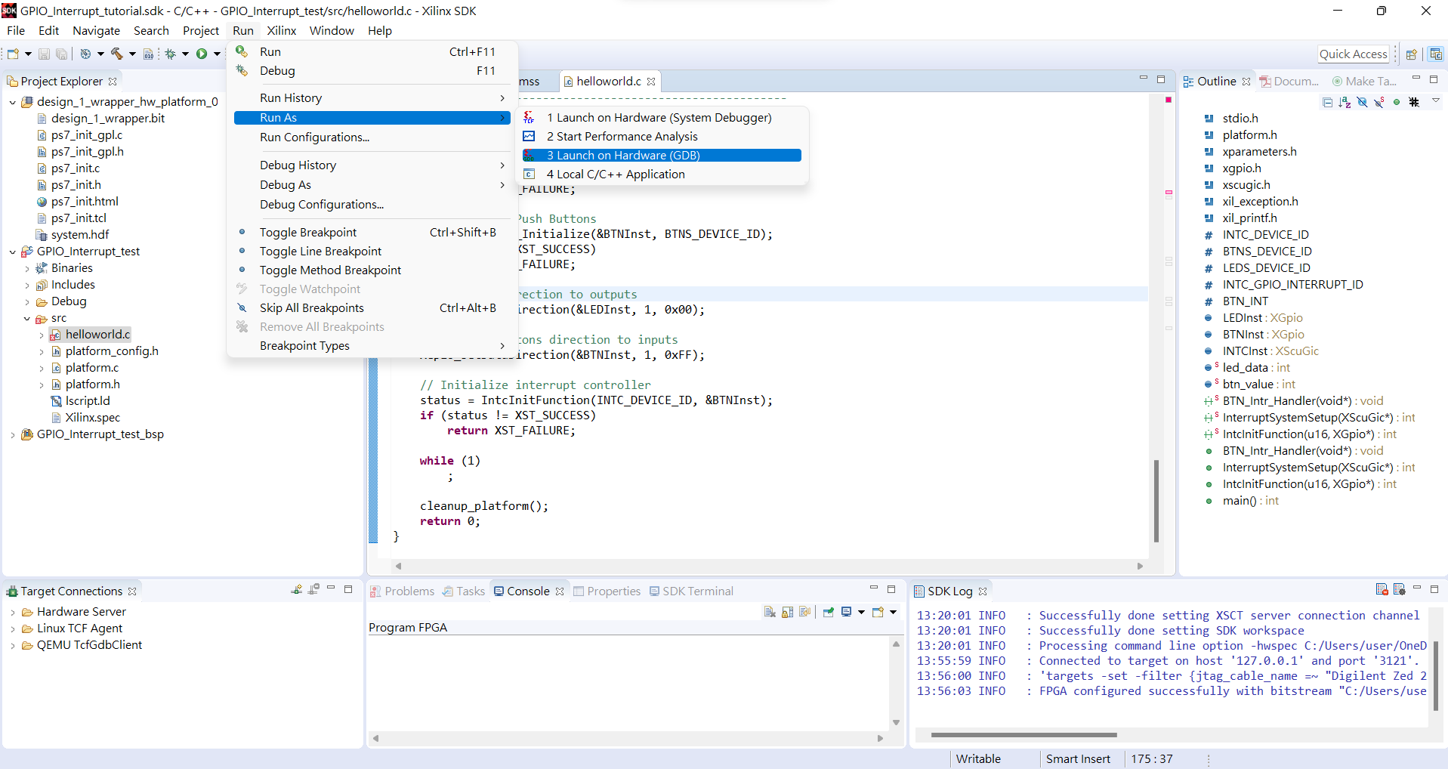
Run → Run As → Launch on Hardware(GDB)

Slide 50
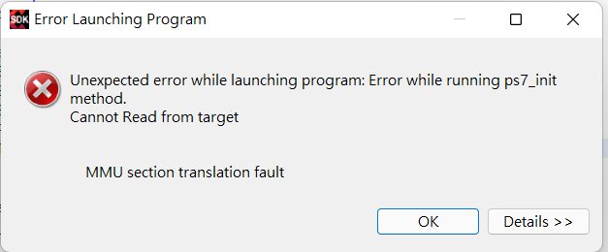
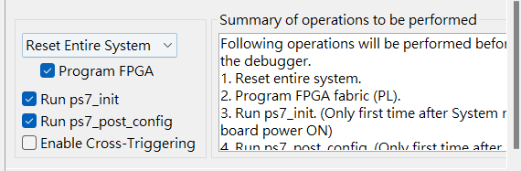
如果出現這種狀況到Run → Run configuration 修改成Reset Entire System

Slide 51
Reference
Problem with ps7_init (xilinx.com)
Xilinx Zynq Vivado GPIO Interrupt Example – YouTube
GPIO interrupt and processes (xilinx.com)

